Slide 1
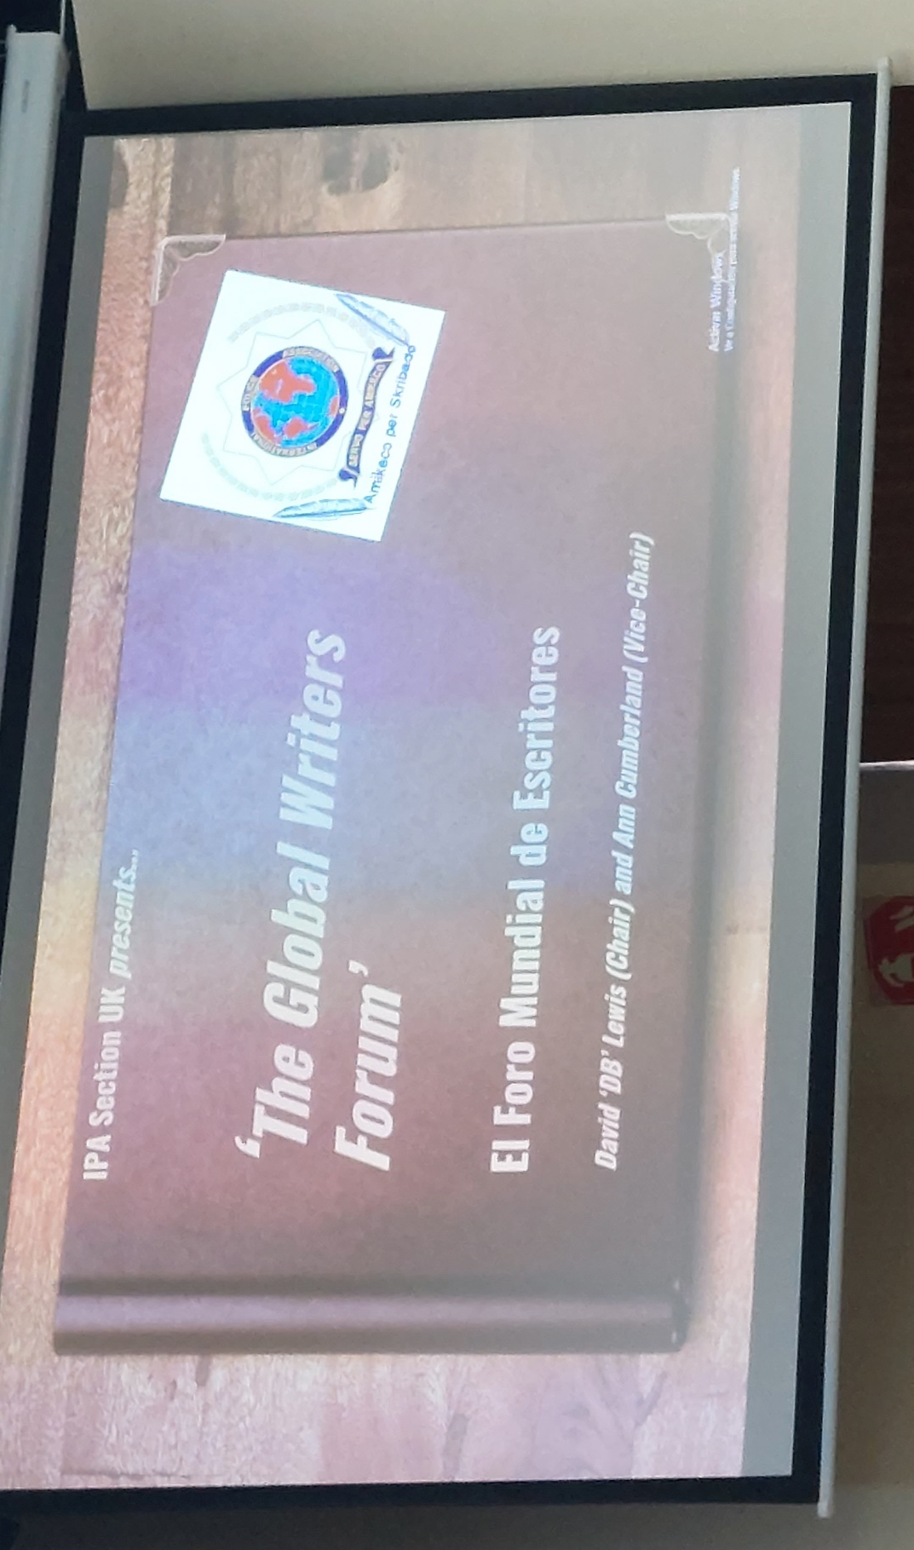

Welcome! Buenos dias! Witamy! Laipni gaidīti ! Välkommen! Willkommen!
The Global Writers
Seminar Series 2023
‘Celebrating Five Years of Success 2018-2023!’
Saturday 1st April 2023
10 a.m, to 2 p.m.

Slide 2

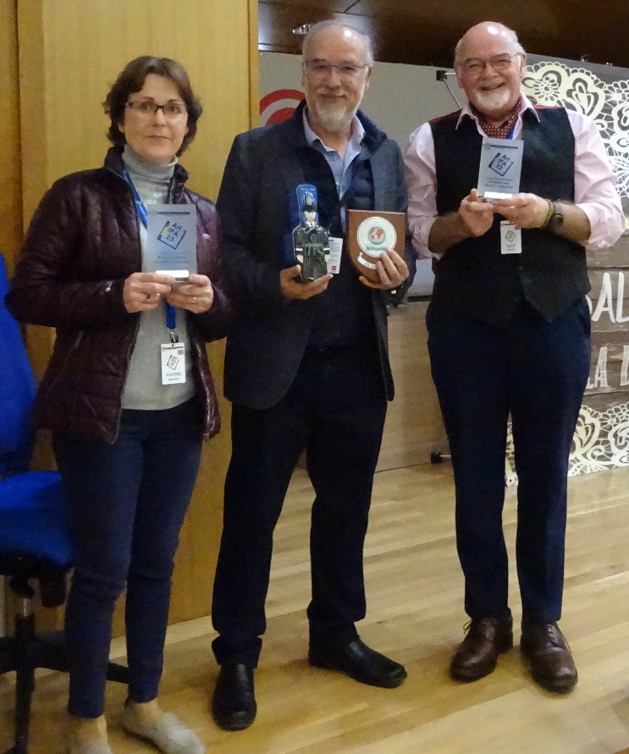
‘Welcome to the Seminar
Teach-In!’
Presenter: David Lewis
The aim
To help us all preserve the standard of English usage that is the hallmark of good writing.

Slide 3
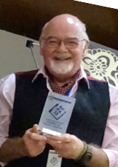
Presenter credibility!
David has degrees in Creative Writing, Education and History and presents English
courses at IBZ Gimborn. He has attended TESL training courses and delivers the English content of ‘English in Policing’ programmes for the London Policing College.
He has seven published books and runs a small publishing business, outsourcing much of the English usage ‘expert’ work, but retaining editorial control of all publications.
Whilst by no means an English expert, he is actively engaged in learning and delivering English content on a daily basis!! He presents only on the basis that he may be the best we have…at present!

Slide 4
What we will be covering:
1. ‘House Styles’
2. Common Errors
3. Good Practice
4. Publishing Tips and Platforms
We will be using group member Mark Thompson’s
latest novel, ‘Eternal City’ as a case study.

Slide 5

‘House Styles:’
Just as architects have different styles for the houses they design so each publisher will have their own ‘house style’:
‘The purpose of a style guide is to set standards for
how you present your writing.’
(Oxbridge Editing)

Slide 6
‘House Styles’
A style guide provides guidance for the visual elements of our writing
It gives rules for the layout of the text on the page, or ’typesetting’
Basically, it indicates how the text should look
Each publisher will have their own ‘style guide’, writers who wish to be considered seriously must comply with this, or risk not being published or worse, being considered to be ‘amateur’

Slide 7
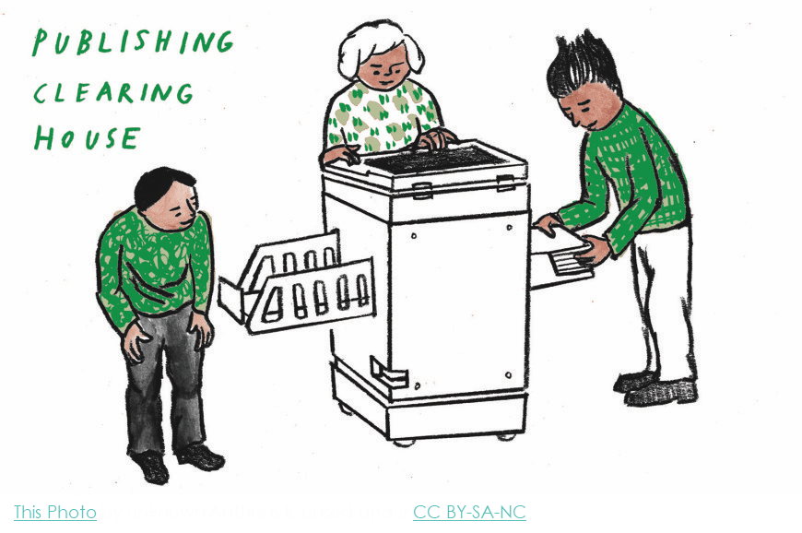
)

Slide 8
House Style:
‘Fussy as it may seem, getting the subtle differences of the house style right is an important part of writing well.
That’s why a style guide is your friend.’
(Oxford University Press)

Slide 9
‘Our House Style’
Set by the publisher:
We start with the stages of style selection:
1. Typeface
There are three main categories of typeface used to convey emotion or style according to the content of the text:
serif
sans serif
script

Slide 10
Style! (Not all buildings are the same are they? They have ‘style’ so does writing…) Firstly, ‘typeface’
serif
Serif fonts are recognizable by the little lines or strokes that extend from letters.
Times New Roman AaBbCc
Garamond AaBbCc
Georgia AaBbCc
Elegant, formal, romantic, well-stablished, trustworthy…
(There are three sub-types too but let’s not go there just yet!)
Notes:
Baskerville, Courier New….www.typewolf.com

Slide 11
Style! (Not all buildings are the same are they? They have ‘style’ so does writing…) Firstly, ‘typeface’
sans serif
Sans serif fonts are recognizable because they have none of the feet or elegance of the serif fonts: this signifies something clean, minimal, friendly, or modern.
Arial AaBbCc
Calibri AaBbCc
Verdana AaBbCc
Young, hip, casual, good for websites, children’s books…

Slide 12
Style! (Not all buildings are the same are they? They have ‘style’ so does writing…) Firstly, ‘typeface’
There are three main categories of typeface:
script
Script fonts are easily recognizable as they appear as ‘handwritten’. They are largely decorative and should be used sparingly. Generally, they are harder to read.
Comic Sans AaBbCc
Blackadder AaBbCc
Dreaming Outloud Aabbcc

Slide 13
Style! ‘’Adhering to a style provides consistency’.
1. Typeface (the terms are slightly confusing but…)
2. Fonts
There are thousands of fonts!:
The ability to use a style properly in formal writing will set your work apart visually. At a glance, a skilled reader will know that you are a skilled writer.
N.B.: Fonts are someone’s design…therefore they are often copyrighted…you may well need to pay for a licence….
Notes:
Google Apache free fonts 950 of them: but still may need a licence

Slide 14

Style! ‘’Adhering to a style provides consistency’.
Louis Sullivan, an architect, once said,
‘Form follows function.’
What is the function of your work?
Select a style that is appropriate:
Children’s book….sans serif….historical novel…serif……humourous book cover? ..consider script

Slide 15
Our House Style for ‘Writes’
Font: Calibri serif, modern, light, clean,
Size: 12 pt (point..fonts come in sizes!)
Line spacing: 1.5
Line spacing: most books are published in either 1.5 or more commonly 1.15 that is the space between lines on the page.
There is much more to style but as our writers seem to find it almost impossible to comply with even this simple requirement, we will progress to common errors…

Slide 16

Top Ten (Too) Common Errors
1. Speech and dialogue errors
2. Ise or ize
3. Formatting and indenting
4. Underlining
5. Use of numbers
6. The ellipsis
7. Possessives
8. Long sentences
9. The Oxford comma and commas generally.
10. Poetry errors

Slide 17
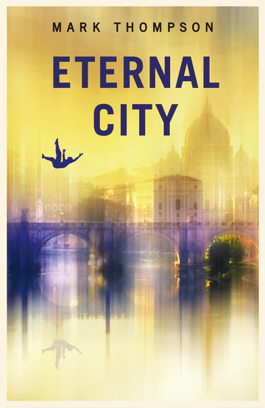
Examples of Good Practice:
‘Eternal City’
2022 novel by Mark Thompson
Use of short sentences
Repetition, repetition, repetition…
Use of a wide a range of ‘English Usage’
techniques
English usage:
the way a particular word or words in English is used :

Slide 18
Top Ten (Too) Common Errors
1. Speech and dialogue errors
English usage changes over time…
Standard publishing English in the UK: ‘single speech marks’
Standard English usage in the U.S.: “double speech marks”
EXCEPT: Newspaper articles (double) children’s books:
(double)
play and script writing: (either is acceptable but: you must be consistent.

Slide 19

Top Ten (Too) Common Errors
1. Speech and dialogue errors
Each new character's speech starts on a new line.
Speech is opened with speech marks.
Each line of speech starts with a capital letter.
The line of speech ends with a comma, exclamation or question mark.
A reporting clause is usually used at the end (said Jane, shouted Paul, replied Mum) except in a continual dialogue between two speakers.
Speech is always indented from the left.

Slide 20
Top Ten (Too) Common Errors
1. Speech and dialogue errors
‘I heard the victim shout “Help, he’s killing me!” just before this guy in a blue and red suit swept down like a parrot on crack.’
‘Really?’ replied the judge, ‘pull the other one, it’s got “Joker” written all over it.’

Slide 21
Top Ten (Too) Common Errors
1. Speech and dialogue errors
‘I want to go on the rollercoaster first,’ decided Jamie, ‘actually on second thoughts, can we go on the log flume first?’
‘It’s such a lovely, sunny day today!’ said Martin. ‘Let’s go to the park.’
‘If you decide to go to the cinema,’ Sally said, ‘then call me.’

Slide 22
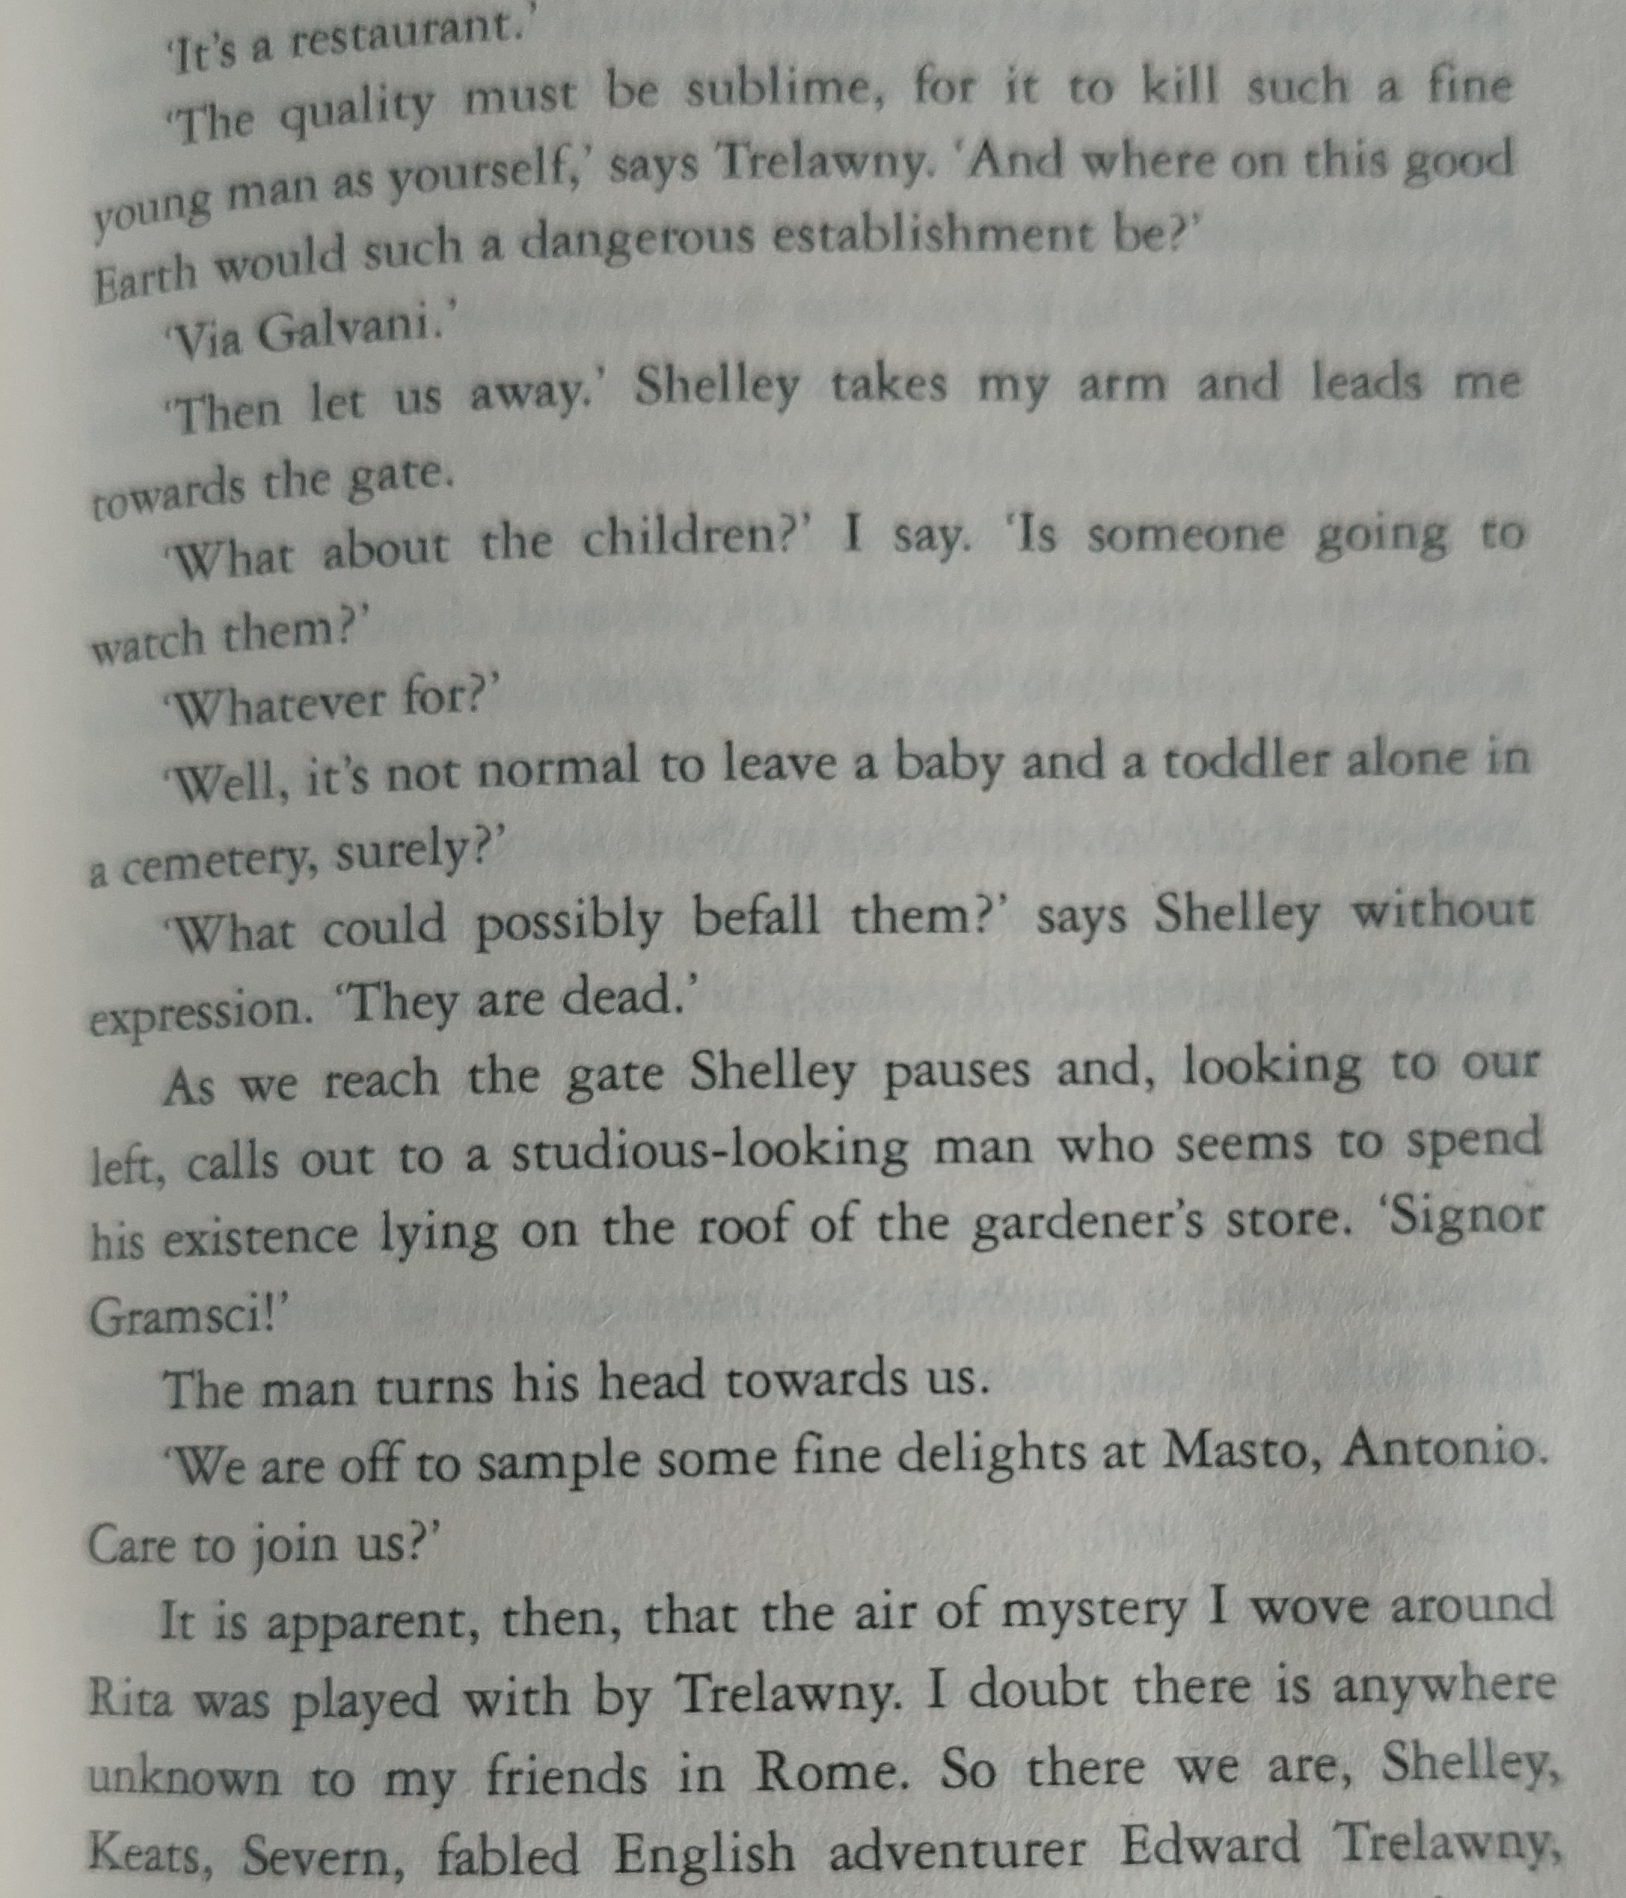

Slide 23
2. Ise…or ize…?
Is it ‘realise’ or ‘realize’?
The answer depends on which English dialect you’re using. For instance, British and Australian English favours ‘realise.’ Oxford, Canadian, and US English uses ‘realize.’
Who uses Oxford spelling?
Oxford spelling is used by many major British publications, like the scientific journal Nature. It’s also the standard used in the Oxford English Dictionary.
‌

Slide 24
The main thing is to be consistent in a given context and to watch out for the words that always take -ise.
These include;
… advertise, advise, apprise, arise, chastise, comprise, compromise, demise, despise, devise, disguise,
enfranchise, enterprise, excise, exercise, improvise,
incise, merchandise, prise, revise, supervise, surmise,
surprise, and televise.
Now go forth and verbalize.

Slide 25
3. Formatting and indenting
This is a special issue for those of us who choose to use Amazon: be careful with the formatting.
If you are submitting to a publisher, you MUST download their formatting guide and comply with it: if not you will not even be looked at.
Formatting a manuscript for a publisher is different to formatting for an online or self-publishing platform.
Read any novels published by mainstream publishers; you will see how the book is laid out: try to emulate this if self-publishing

Slide 26
4. Underlining…almost never used in publishing except perversely by www.gov.uk
Get support with the cost of living
Find out about help you can get with your energy bills
Find a job
Coronavirus (COVID-19)
Universal Credit account: sign in
5. Use of numbers… (depends on the ‘style’ being used..of course!)
One, two, three, four, five, six, seven, eight, nine, 10.
Nineteen-eighty was the year I first…
The twelve days of Christmas…one in twenty people
3 pounds 5 cm 6.2 per cent 7 years old 7-year-olds 10 a.m.

Slide 27

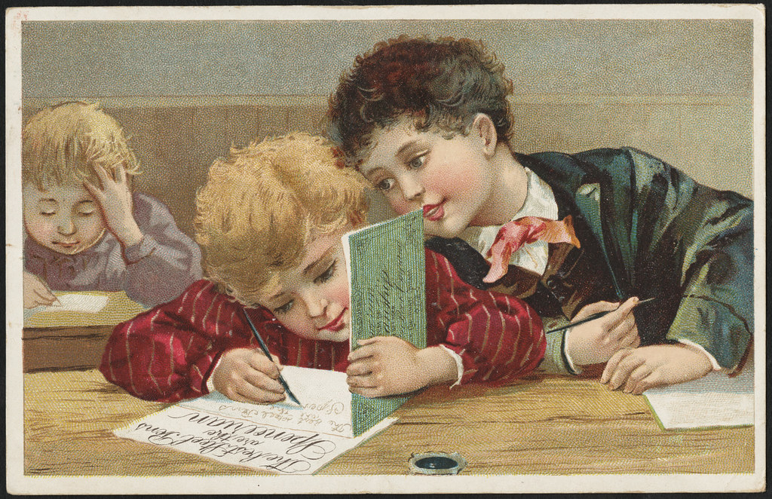
6. ellipses: … or ….
7. possessives: the boy’s bow tie
the writer’s pen
the writers’ pen… ?
This Photo by Unknown Author is licensed under CC BY

Slide 28
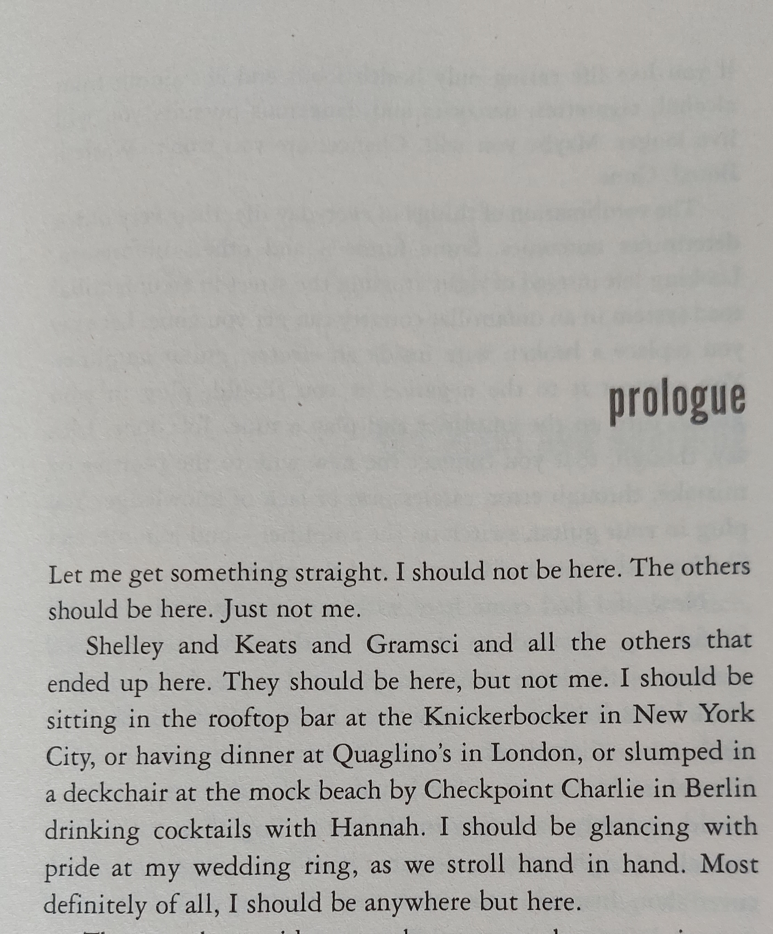
8. Long sentences

Slide 29
9. Commas,
There are four types of commas:
the listing comma: Vanessa seems to live on eggs, pasta and aubergines. But note the Oxford comma below…
the joining comma: The report was due last week, but it hasn't appeared yet.
the gapping comma: Jupiter is the largest planet and Pluto, the smallest.
the bracketing comma: We have a slight problem, to put it mildly.
The Oxford, or serial comma…France, Italy, and Spain,…( list of three or more)

Slide 30
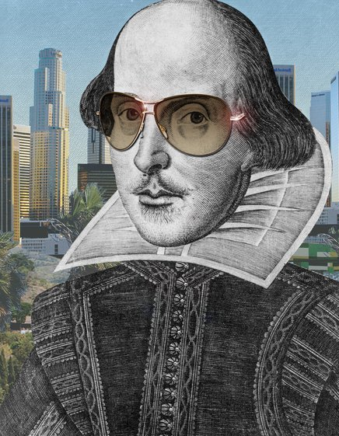
10. Poetry errors
This is a poem writ for thee
Which says I am a poet
My lines they scan
Like poetry can
So why not follow me…?
This is the session for a special poetry workshop coming soon at The Global Writers Forum…sign up without delay!

Slide 31



‘The 2023 Prize Drabble Competition’
Rules of entry:
The subject of your story of exactly 100 words is ‘Duplicity’
This can be in any genre, non-fiction or fiction but not poetry.
Entries should be typed in a Word document only, using Calibri 12 pt 1.5 spacing!
Closing date: Monday 1st May 2023 at 1200
There are three excellent sponsored prizes to be announced now!
THE IBZ GIMBORN SEMINARS

Slide 32
‘Writers Five…English for All’
2 -6 October 2023
THE IBZ GIMBORN SEMINARS
Presenters: Wendy Curtiss and David Lewis

